Slide 1


Dr. N.G.P. INSTITUTE OF TECHNOLOGY
Coimbatore - 48
(Approved by AICTE, New Delhi & Affiliated to Anna University, Chennai
Recognized by UGC & Accredited by NAAC A+ and NBA (CSE, BME, EEE, ECE and Mech) Dr.N.G.P. Nagar, Kalapatti Main Rd, Coimbatore, Tamil Nadu 641048
Ph No: 0422 - 236 9105, Fax: 04222369106, E-mail: info@drngpit.ac.in
DEPARTMENT OF INFORMATION TECHNOLOGY
SMART WHEELCHAIR
Guided By
Ms.J.Dharani, M.E.,
Assistant Professor/ IT
Team Members
1.Mr.M.Karthick (710720205058)
2.Mr.M.Sabarikrishnan (710720205045)
3.Mr.M.Karthick (710720205020)

Slide 2
OUTLINE
Objective
Problem Statement
Existing Methods
Proposed Methods
Flow Diagram
Hardware Specification
Software Specifications
Results
Conclusion
Future Scope
References
9/5/2023
Smart wheelchair

Slide 3
OBJECTIVE
The objective of a smart wheelchair is to reduce user effort in controlling the wheelchair and to ensure safety during movement.
Our focus is to design and develop a smart wheelchair using inexpensive hardware and open-source software so as to make it affordable to a larger section of the target population, particularly in developing nations.
The user can control the wheelchair using three interfaces namely, smart phone , microphone and joystick.
9/5/2023
Smart wheelchair

Slide 4
PROBLEM STATEMENT
The wheelchairs available in market are too expensive and are beyond the reach of poor and middle class families. Most of the Wheelchairs are single functioned either it will be operated with remote or joystick. We are designing a wheelchair that will be a low cost and multifunction.
This project aims to make life easier for the disabled and elderly people who cannot move properly it will enable them to lead better lives without any problem.
9/5/2023
Project Title

Slide 5
EXISTING METHODS
It uses simple LEDs, photo sensor, motor and microcontroller to control the movement of wheelchair.
Wheelchair that moves based on person eye ball movement
By using joystick and Remote control wheelchair to be controlled
Based on the person hand movement wheelchair to be operated
9/5/2023
Smart wheelchair

Slide 6
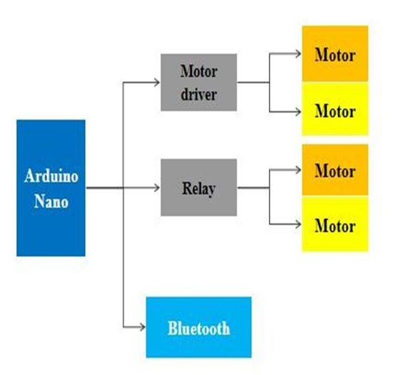
PROPOSED METHODS
9/5/2023
Smart wheelchair

Slide 7
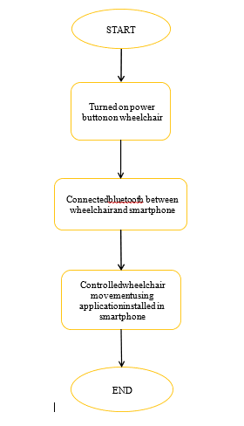
FLOW DIAGRAM
9/5/2023
Smart wheelchair

Slide 8
HARDWARE SPECIFICATIONS
Hardware Requirement
    Arduino Board
    L293D Motor Shield
    Bluetooth Module HC-05
    Wheel chair chassis.
    Battery 12 volts.
    4 DC Motors (12 V 200 rpm).
    Android phone.
    Battrey Holder.
9/5/2023
Smart wheelchair

Slide 9
SOFTWARE SPECIFICATIONS
Software Requirement
    Arduino IDE.
    Android Application.
    Coding language: Arduino programming (C).
9/5/2023
Smart wheelchair

Slide 10
RESULTS
The project was tested for the movement of the wheel chair using Bluetooth module after the design and development of the self-automated wheel chair with its various interfacing units.
On the basis of two important aspects, firstly, on the accuracy of the signal system and secondly, wheelchair velocity by means of control commands this design is experiment.
For a next time we will test it with a different user on whom the system was not trained .
9/5/2023
Smart wheelchair

Slide 11
CONCLUSION
Since 90% of the people own a smart phone, smart wheelchair is one of the best solutions. As the person can remotely control the wheelchair using smart phone the proposed system becomes more helpful and efficient.
This gives him confidence for his life carrier. The patient monitoring system on the wheelchair will be constantly monitoring the health of the patient. If any abnormality is detected, the system will alert to the relative or doctor.
Thus, this system greatly helps the patients with lower limb impairment.
9/5/2023
Smart wheelchair

Slide 12
FUTURE SCOPE
  Voice recognition module is used to develop the voice recognition system. Voice recognition issues a Command to control the movement of wheelchair.
  Using gear box we can produce high speed moving wheelchair.
  PWM modulation can also increase speed.
  Solar Panel can also be used to charge the battery for power supply to the components required to drive the wheelchair
9/5/2023
Smart wheelchair

Slide 13
REFERENCES
Chin-Tuan Tan and Brian C. J. Moore, Perception of nonlinear distortion by hearing-impaired people, International Journal of Ideology 2008,Vol. 47, No. 5 , Pages 246-256.
Oberle, S., and Kaelin, A. "Recognition of acoustical alarm signals for the profoundly deaf using hidden Markov models," in IEEE International symposium on Circuits and Systems (Hong Kong), pp. 2285-2288., 1995.
A. Shawki and Z. J., A smart reconfigurable visual system for the blind, Proceedings of the Tunisian-German Conference on: Smart Systems and Devices, 2001.
C. M. Higgins and V. Pant, Biomimetic VLSI sensor for visual tracking of small moving targets, IEEE Transactions on Circuits anSystems, vol. 51, pp. 2384– 2394, 2004.
9/5/2023
Smart wheelchair

Slide 14
REFERENCES (Contd.,)
http://electronics.howstuffworks.com/gadgets /hightech-gadgets/speechrecognition.html
S. Panigrahi, A. Nanda, and T. Swarnkar, ``A survey on transfer learning,'' Smart Innov. Syst. Technol., vol. 194, pp. 781789, Oct. 2020, doi: 10.1007/978-981-15-5971-6_83.
A. H. Ombabi,W. Ouarda, and A. M. Alimi, ``Deep learning CNNLSTM framework for Arabic sentiment analysis using textual information shared in social networks,'' Social Netw. Anal. Mining, vol. 10, no. 1, pp. 113, Dec. 2020, doi: 10.1007/s13278-020-00668-1.
S. Al-Dabet, S. Tedmori, and M. Al-Smadi, ``Extracting opinion targets using attention-based neural model,'' Social Netw. Comput. Sci., vol. 1, no. 5, pp. 110, Sep. 2020, doi: 10.1007/s42979-020-00270-4.
W. Antoun, F. Baly, and H. Hajj, ``AraBERT: Transformer-based model for Arabic language understanding,'' in Proc. 4th Work. Open-Source Arab. Corpora Process. Tools, Shar. Task Offensive Lang. Detect., May 2020., pp. 915.
9/5/2023
Smart wheelchair

Slide 15
THANK YOU
9/5/2023
Smart wheelchair

